Slide 2
Accessibility

Slide 3
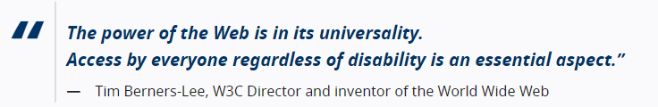
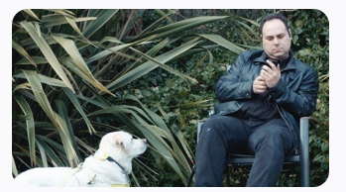

Accessibility :Web
Web accessibility means that websites, tools, and technologies are designed and developed so that people with disabilities can use them. More specifically, people can:
perceive, understand, navigate, and interact with the Web
contribute to the Web

Slide 4

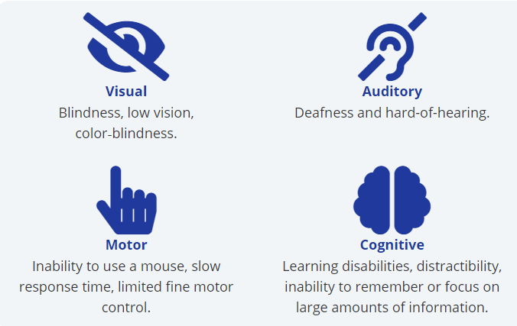
People with Disabilities on the Web
The internet is one of the best things that has ever happened to people with disabilities.
Screen reader software - Designed to read online content aloud for Blind people.
Screen Magnifiers – Present enlarged screen content.
Eye gaze systems
Touch screens
Alternative input devices- joystick, trackballs
Notes:
Web accessibility also benefits people without disabilities, for example:
people using mobile phones, smart watches, smart TVs, and other devices with small screens, different input modes, etc.
older people with changing abilities due to ageing
people with “temporary disabilities” such as a broken arm or lost glasses
people with “situational limitations” such as in bright sunlight or in an environment where they cannot listen to audio
people using a slow Internet connection, or who have limited or expensive bandwidth

Slide 5

HTML Accessibility Techniques
Text Accessibility Techniques
Image Accessibility Techniques
Table Accessibility Techniques
Form Accessibility Techniques

Slide 6
Text Accessibility Techniques
<html lang=“en”>
Specify the languages used for screen readers
<title> Home | RGU </title>
Screen readers uniquely identify pages
<h1>Heading</h1>… <h2>Heading</h2>
Use of proper headings help structure document, read by Screen readers
<meta name=“author” content=“Janani H”>
Why specifying keywords?
Use <p>, <em>, <blockquote>, <ul>…
Read by screen readers, improve consistency

Slide 7




Image Accessibility Techniques
<img src=“flower.jpg” alt=“sunflower”/>
Informative images - Alt= A short description conveying the essential information presented by the image.
<img src=“flower.jpg” alt=“”/>
Decorative images – Alt=“” purpose of an image is to add visual decoration to the page
<img src=print.png alt=“print this page”/>
Functional Images–Alt=“describe the functionality of the link or button ”
<img src=“sig.jpg” alt=Your access to the city”/>
Images of Text – Alt =“images of text are used, the text alternative should contain the same words as in the image.”

Slide 8



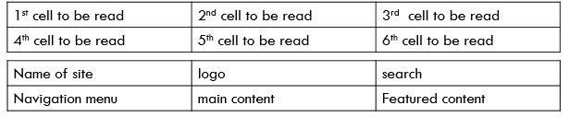
Table Accessibility Techniques
Tables with one header for rows or columns
Mark up header cells with <th> and data cells with <td> elements
Tables with two headers have a simple row header and a simple column header:
Define the direction of each header by setting the scope attribute to col or row.
A caption identifies the overall topic of a table and is useful in most situations. A summary provides orientation or navigation hints in complex tables.
Table linearization :Avoid tables for layout - > Use CSS
Caption & Summary
<table summary =“……………………”> <caption>Caption description</caption></table>
Violates separation of content and presentation
Causes problems for
Screen readers
Text browsers
Narrow-width browser windows

Slide 9
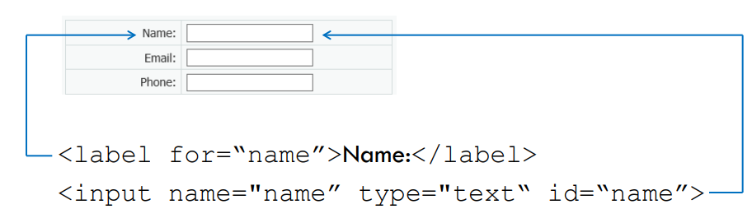
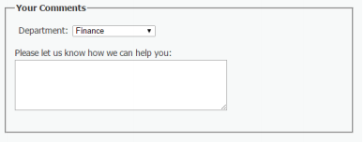


Form Accessibility Techniques
Use Explicit Labels – Supported with Screen readers
<label for = “name”>Label Text </label>
Grouping –filedset and legends
<fieldset> <legend>Contact information</legend>
<input type=“text” id =“fieldname”>
<label for = “email”>Email</label>
<input type=“email” id =“email”>
<fieldset>
Indicate required fields – Avoid using colors to for them
Use progress bar
<label for=“name” >Name*</label>
<input required aria-required=“true” type=“text”>
Survey <progress value="3" max="7">Step 3</progress>

Slide 10
Why HTML Accessibility Techniques important?
Screen readers
Read alternative text
Read row, column headers in tables
Speech input software
Linked image with a single voice command
Use the labels via voice commands to activate form controls
People with cognitive disabilities
Mobile web users
People browsing speech-enabled websites
The text alternative can be read aloud
Helps to understand and complete forms
Images can be turned off, especially for data-roaming

Slide 11
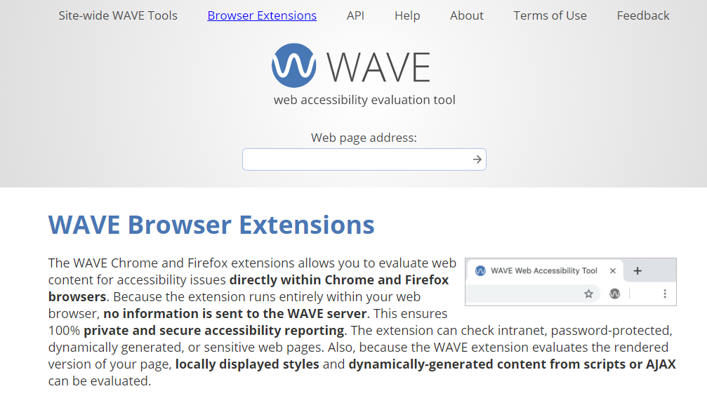
Check Accessibility
Notes:
Click on the link above
Download the Wave plugin for firefox or chrome
Upload HTML files
And Right Click and Check for the accessibility test

